Slide 1
LOAN ANALYSIS
In the following slides, we are going to present some key insights found while analyzing the loan data of the financialZ Company. Without further Ado, let’s begin!!!
PLAN
Loan repartition By Category
Loan repartition By Province
Loan Dlq Status
Summary of findings

Slide 2
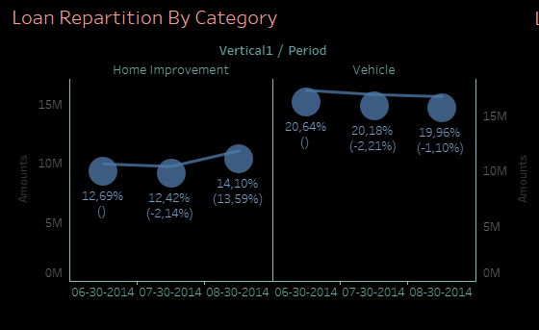

Slide 3
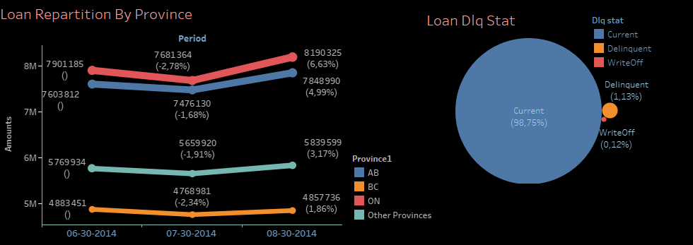

Slide 4
SUMMARY OF FINDINGS
From the charts above we can see that:
An increase of (13.59 %) for « home improvement » loans and a decrease of (1.10%) for « vehicle » loans.
A general increase as compared to the previous month(July) for loans in all the provinces.
All most 0% of « write-off » loans .
By combining all the information gathered in our charts, we can say that we are doing well so far with most of our loans being in the « current » status and very few in « delinquent » or « write-oof » status.

